Slide 1
COMPLEX TISSUE
Complex tissue is made up of more than one types of cells.
They work together.

Slide 2
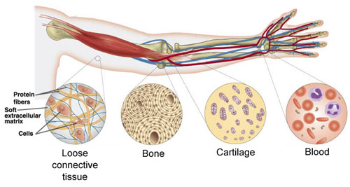
Types of Complex tissues
Connective tissue :
Connective tissue consists of matrix.
The cells are embedded in the matrix.
The nature, density and amount of the matrix differs depending upon the function of the particular connective tissue.
The matrix may be jelly-like, fluid, dense or rigid.
This can be explained from the different types of connective tissue as given below.
i. Bone ii. Blood
iii. Ligament iv. Tendons
v. Cartilage vi. Areolar
Adipose
Let us see them one by one
Intra cellular substance
Fixed
Thick
Hard

Slide 3
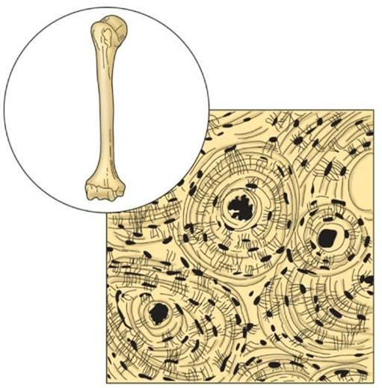
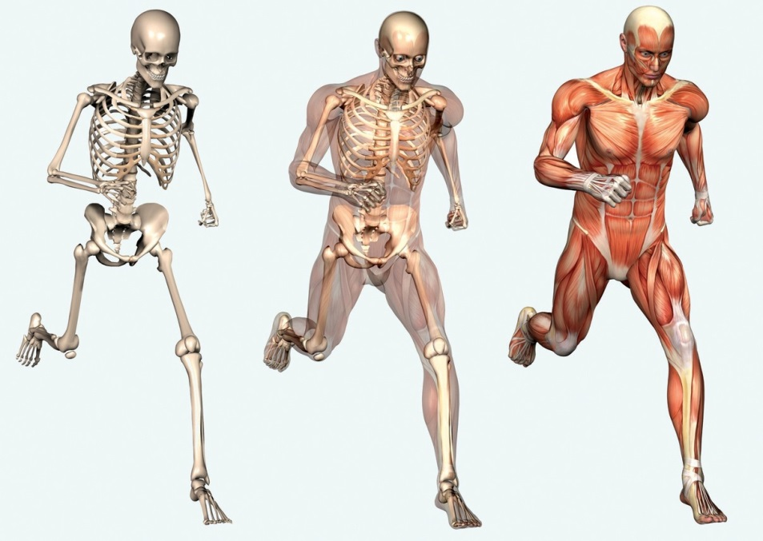

Types of connective tissue :
i. Bone :
Matrix
It forms the supporting framework of the body.
It also anchors the muscles and supports the main organs of the body.
It is a strong and non-flexible tissue.
Bone cells are embedded in the hard matrix that is composed of calcium and phosphorous compounds.
Bone cells

Slide 4

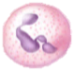



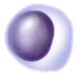
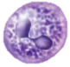

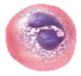
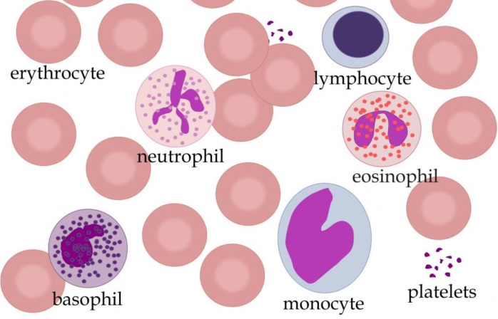
Types of connective tissue :
RBCs
ii. Blood :
WBCs
Blood is a fluid connective tissue.
It has a fluid matrix called plasma in which red blood corpuscles (RBCs), white blood corpuscles (WBCs) and blood platelets are suspended.
The plasma contains proteins, salts and hormones.
Blood transports, gases, digested food, hormones to different parts of the body.
Platelets
Proteins
Salts
Plasma

